Slide 1

How do we measure Economic Growth?
Year 10 Economics

Slide 2
Economic Growth
GDP:
What is it?
How is it measured?
Refinements of GDP
Limitations of GDP

Slide 3
What is Economic Growth
The increasing capacity of the economy to satisfy the wants of its society.
Describes the way the real income of an economy increases over time.
Growth enables us to achieve a higher material standard of living.
A nation’s growth is usually measured in terms of GDP.
Notes:
Real income is income of individuals or nations after adjusting for inflation. It is calculated by subtracting inflation from the nominal income.

Slide 4
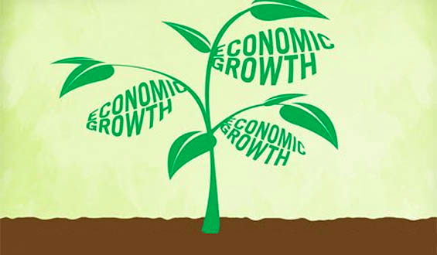
Macroeconomic Policy Objectives
Economic Growth
What other policy objectives does economic growth link with?
Full Employment
Price Stability

Slide 5
Economic Growth – PPF Model
The PPF Model
Actual and potential
Output gap
Thinking back to the characteristics of the phases of the BTC, when would you have a positive output gap and when would you have a negative output gap? Why?
Notes:
Draw the PPF model
Definition: PPF curve shows the maximum combination of any two goods which an economy could produce when all resources are being fully employed and efficiently utilised.
Actual growth: when a economy is producing within its PPF and moves closer to the PPF indicates actual growth
Potential growth: the productive potential of an economy may be increased by an increase in the quality and/or quantity of resources and, when this occurs, this is known as potential growth. Denotes an increase in the productive capacity or potential of the economy as more of both goods can now be produced.
Output gap: measure of the difference between actual output and potential output – OG=AO-PO
Link output gap to the BTC: negative output gap: in a trough/downswing – economy is producing less than potential, there will be unemployment, low growth and or a fall in output, typically cause low inflation or even deflation. Positive output gap: in boom/peak – economic growth is above the long run trend rate, actual output greater than potential output, firms will ask workers to do overtime, inflationary pressures.

Slide 6
Measuring Economic Growth
Growth rate: Annual % change in GDP
(GDP2-GDP1)/GDP1 x 100
What does it mean if the GDP growth rate is:
2.1%?
-0.2%?

Slide 7
Measuring GDP using Aggregate Demand
The most common method of measuring GDP is using the Aggregate demand method:
Aggregate Demand = C + I + G + (X-M)
Consumption
Investment
Government Expenditure
Net Exports

Slide 8
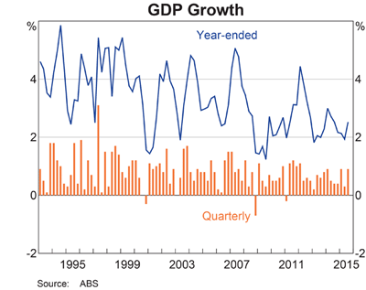
Notes:
Looking at our GDP growth rate, can we see any economic events reflected in the data?

Slide 9
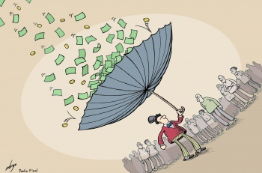
Why are some countries ‘rich’ and other countries ‘poor’?
Brainstorm: Why do you think some countries are well off and others are not?
https://www.youtube.com/watch?v=UHiUYj5EA0w

Slide 10
For Economic Growth to Occur
Growth can come from either
Supply Side
Quality or quantity of the Factors of Production
Land
Labour
Capital
Enterprise
Demand Side
Factors that affect spending in the economy
Consumption
Investment
Government expenditure
Net Exports (Exports – Imports)

Slide 11
Activity
1. Search the Internet for articles on China’s rate of economic growth. Read the articles and ascertain the reason(s) for China’s initial high rate of economic growth (10% and higher) and the reasons for its current slow down to a rate of growth of approx. 6 – 7%.
2. Is there any connection between the theoretical causes of economic growth and the drivers of China’s economic growth? Which aspects apply to China. Give examples.

Slide 12
Limitations of the GDP measure
GDP doesn’t include non-market production
GDP doesn’t provide information about the distribution of production
GDP doesn’t consider the impact of production on the environment
GDP involves some ‘guestimates’ of production.
Notes:
GDP doesn’t include non-market production
If someone carries out jobs around their own home that could be done by a paid worker they are contributing to economic growth, but this contribution is not included because it can’t be measured. For example, when someone paints their own home, the Australian Bureau of Statistics can’t put a value on the work done, so this is not included in the official GDP figures.
GDP doesn’t provide information about the distribution of production
GDP only measures changes in the quantity of goods and services produced but there is no information regarding who receives this increased number of goods and services. If the increased production is not shared equally among the citizens of the economy, it can be argued that the economy hasn’t really ‘grown’.
GDP doesn’t consider the impact of production on the environment
Increased production can mean increased pollution, quicker deterioration of the environment, depletion of non-renewable resources and increased climate change. These effects are referred to as negative externalities as they are considered negative outcomes of production. These externalities will all negatively impact our national wealth in the future.
GDP involves some ‘guestimates’ of production
The value of some non-marketed (not sold) production making up GDP has to be ‘guestimated’, leading to inaccuracies. For example, estimations are made for the part of a farmer’s production that is consumed on the farm, as is the annual value of accommodation provided by houses occupied by their owners. This leads to inaccuracies in Australia’s GDP figures.

Slide 13
Benefits of Economic Growth
Satisfy more wants and needs
Increase material standard of living
Access to more goods and services of a better quality
Increase levels of ‘real’ income
Reduce unemployment
G run budget surplus (pay back G debt)
Increase business investment

Slide 14
Costs of Economic Growth
Structural unemployment (to be discussed later)
Demand pull inflation (to be discussed later)
Environmental Degradation
Social dislocation

Slide 15
Other Indicators of Economic Growth
GDP is the economic indicator of Economic Growth.
It is quantitative, and easy to compare over time and with other nations. This makes it valuable.
But when comparing Standard of Living / Quality of Life, what other factors could / should be included?

